Slide 1
Everyone at Their Best
FRENCH LANGUAGE LEARNING IN NEW BRUNSWICK
Notes:
Welcome to this presentation on New Brunswick French second language programs. No matter where you live, your child will learn French within the anglophone sector. Thank you for taking the time to review this short information session to learn more about French Second Language as part of your child’s education.

Slide 2
Why Learn French
CLICK TO WATCH VIDEO
Notes:
Please watch this video on the benefits of learning another language!

Slide 3
French Second Language Programs for 2023-24
FRENCH INSTRUCTION IS PART OF ENGLISH PRIME IN ALL SCHOOLS
K to Grade 4: introduction to French through Cultural Experiences/FLORA resources and Pre-Intensive French
Grade 5: Intensive French
Grades 6 to 12: Post-Intensive French
FRENCH IMMERSION
Offered in a community where there is sufficient interest and where it is deemed to be sustainable over time as per Policy 309.
Grade 1 (Early entry)
Grade 6 (Late entry)
Notes:
There are multiple French programs in New Brunswick:
Pre-intensive, Intensive and Post-Intensive French are offered in all schools for English Prime students. As well, all students in the primary grades participate in French language and cultural learning experiences to support positive attitudes and introduce some simple French vocabulary. In some schools, elementary students may be learning French through FLORA resources.
Where offered, students may enter French Immersion in Grade 1 or in Grade 6, based on the guidelines outlined in Provincial Policy 309.
For all programs, French is compulsory until the end of Grade 10. In Grades 11 and 12, there are additional opportunities to build French Language skills.
Each French Second Language program is guided by achievement indicators that describe the desired levels for speaking, reading and writing in French. Students are provided with opportunities to use French in various contexts while building their language skills.

Slide 4
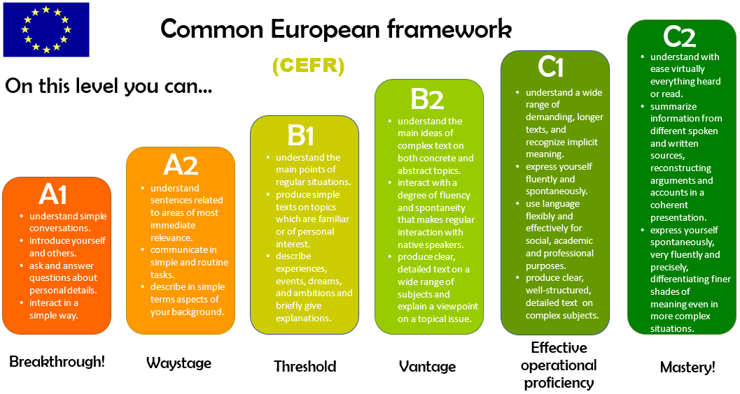
All New Brunswick French Programs are CEFR aligned
CEFR stands for: Common European Framework of Reference
It is an internationally recognized framework that can be adopted and used in multiple contexts and applies to all languages.
The descriptors in the CEFR specify progressive mastery of each component of language (oral, reading and writing) on a six-level scale.
It highlights the progression of bilingualism.
Bilingualism is a life-long journey
English poster may be found at https://bit.ly/3kHLeMs
Notes:
CEFR stands for: Common European Framework of Reference.
This is an internationally recognized framework for additional language learning – that provides descriptors for listening, speaking, interacting, reading, and writing on a six-level scale.
It highlights the progression of bilingualism and demonstrates that language learning is a life-long journey.
New Brunswick has introduced CEFR-based posters to help learners understand their progress in French.
The proficiency levels are based on the levels described in the CEFR. They are available in English and French.

Slide 5
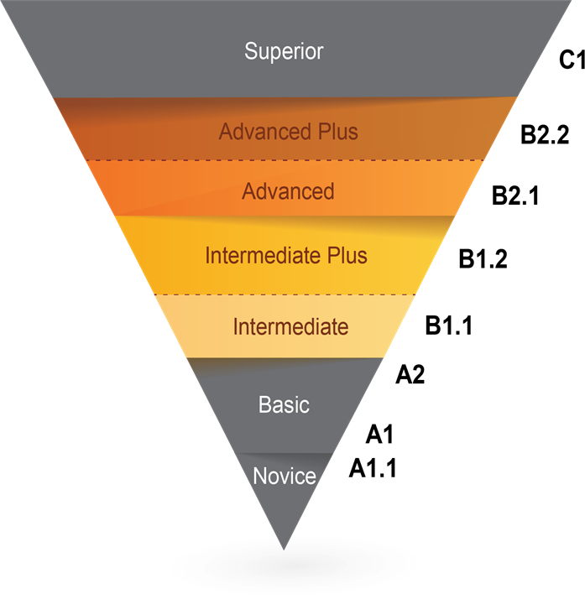
Oral Proficiency Levels
The level of French that learners attain will vary from one student to another, in the same way as performance varies in other areas.
Time spent learning and interacting In French will impact the level of proficiency achieved
Notes:
There are achievement indicators for each French Second Language program. Keep in mind that the level of French that learners attain will vary from on student to another, in the same way as performance varies in other subject areas.
Hover the mouse over each audio icon to reveal the audio control bar. Then, click on the play icon to hear examples of what to expect at various levels.

Slide 6
Now, let’s take a look at the programs:
ENGLISH PRIME
*Please note: the prescribed programs in this presentation may not be exactly as described if your school is participating in the Language Learning Opportunities prototypes.
Notes:
The next part of this presentation will take a look at the various language programs that are offered in New Brunswick. Please note, the prescribed programs in this presentation may not be exactly as described if your school is participating in the Language Learning Opportunities prototypes. Under this initiative, school teams are using an innovation design process to improve French language learning which may result in adjustments.
Now let’s look at the English Prime program.

Slide 7
English Prime Program Overview
K to Grade 4: introduction to French through Cultural Experiences/FLORA resources and Pre-Intensive French
Intensive 5-month block typically offered in Grade 5 (occasionally occurs in combined 4/5 classes).
At the end of Grade 5, there are two program options: French as part of the Post-Intensive program or Late French Immersion (as per Policy 309).
French instruction is part of the curriculum from Grades 4−10 and is an elective in all schools in Grades 11−12.
Notes:
For all learners in the English Prime Program in grades K-4, French instruction starts with an introduction to language and cultural experiences. Some schools are using FLORA resources for this purpose. In Grade 4, learners will be introduced to more explicit French language learning. In Grade 5, EP students learn French in an intensive 5-month block. In Grade 6, students may enroll in late immersion in schools where the program is available or will continue with a required Post Intensive French course in their schedule until the end of Grade 10. They can choose to continue French courses in Grades 11-12 – including language arts and other subjects offered in their school.

Slide 8
French Learning Opportunities for Rural Areas (FLORA)
is a made-in-New Brunswick French resource for early language acquisition that includes educational songs, animated characters, readings and activities
can be accessed from home to support in-class learning and for fun
uses the same approach as Intensive French where modelling the language is central
https://flora.nbed.nb.ca
Notes:
FLORA (French Learning Opportunities for Rural Areas):
Is a made-in-New Brunswick French resource for early language acquisition that includes educational songs, animated characters, readings and activities
The resources are flexible and online materials can be accessed from home.
It is used in some schools in K-3 to introduce French culture and language, as well as in grade 4 to prepare for Grade 5 Intensive French.

Slide 9
Intensive French: 2 blocks
First Term (5 Months) Intensive French Block | Second Term (5 Months) Non-Intensive French Block
September – January ← → February – June
French Language Arts Development of literacy skills in French | English Language Arts Science (English) Social Studies (English) Well-Being (English)
 | French Language Arts
Mathematics (English)
Physical Education, Music, Art (English)
Intensive Block | Non-Intensive Block
Warm-up (French) | English Language Arts
Message of the day: word work and sound work (French)
Oral (French) | Science (English)
RECESS | RECESS
Oral (French) | Social Studies (English)
Reading (French) | Well-Being (English)
LUNCH | LUNCH
Writing (French) | French
Math (English) | Math (English)
Physical Education, Music, Art (English) | Physical Education, Music, Art (English)
TYPICAL YEAR
TYPICAL DAY
Notes:
In Grade 5, there are 2 blocks: for 5 months, 60% of the day is in French. The other 5 months, 9% of the day is in French. The Intensive block uses a literacy-based approach to develop students’ capacity to speak, read and write in French. In Grade 5, some subject areas are compacted and instructed during the non-intensive block.
The Intensive French Block can be offered in either term, as demonstrated by the arrows in the first table. During this block, there is a heavy emphasis on language arts which is beneficial to learners’ overall language development in both French and in English.
The second table represents a typical day in both the Intensive and the non-Intensive blocks in grade 5.

Slide 10
English Prime with Intensive French (Grades 6-12)
POST-INTENSIVE FRENCH GRADES 6−8
2−3 blocks/classes per week of French
Focuses on further development of oral, reading, and writing communication skills
POST-INTENSIVE FRENCH GRADES 9−10
1 course per year
Reading texts that include greater complexity
Writing tasks are more complex
POST-INTENSIVE FRENCH GRADES 11−12
Available for all students
Both courses are available online
Upon approval learners may select additional courses in
French (e.g., Writing 110, Law 120)
Notes:
Students who learn French as a second language through the English Prime program will continue until Grade 10. From Grades 6 through 8, 12% of the weekly instructional time is in French.
Learners will have the opportunity to improve their language skills and aim for higher oral, reading and writing competencies. More complex learning will take place in Grades 9 and 10, where there is one course at each level.
Learners enrolled in a French course in grade 12 are eligible for an oral proficiency interview through the province of NB.
The online courses for Post-Intensive French 110 and 120 allow for all learners to access quality French instruction. These courses have a strong oral component and are interactive in nature. In grades 11 and 12, English Prime learners who are deemed to be at the intermediate level by school personnel
may enroll in any course offered in French. There are online courses offered in French at every high school – including, Coop Education, Intro to Environmental Science, Hospitality and Tourism, Law, Writing, and Techniques de Communication.

Slide 11
Benefits of Learning French
Fosters stronger literacy skills in both French and English
Develops listening and learning skills
Enhances problem solving abilities
Increases cognitive abilities such as flexible and creative thinking
Exposes learners to literature, art, music and theatre in another language
Improves self-esteem and attitude towards French
explore a variety of themes of interest (e.g., me, my family, food, clothing, leisure, and activities: sports, music, etc.).
Notes:
French fosters stronger literacy skills in both French and English, develops listening and learning skills, provides fluency and accuracy in French, enhances problem solving abilities, increases cognitive abilities such as flexible and creative thinking, exposes learners to literature, art, music and theatre in another language, and improves self-esteem and attitude towards French by exploring a variety of themes.
Intensive French is readily adaptable to include varied learning styles and abilities. It incorporates the three strands of language: oral, reading, and writing. Language is learned through modeling and practice while students work to improve their oral proficiency in French.

Slide 12
Now, let’s take a look at the French Immersion Programs
Notes:
Now let’s explore the French Immersion programs! ☺

Slide 13
French Immersion Overview
LANGUAGE PROFICIENCY TARGETS
Learners work towards French language achievement indicators in the areas of oral proficiency, reading, and writing.
PROGRAM AVAILABILITY
Spring registration supports district planning.
Families are encouraged to register within the designated dates.
Program availability is dependent upon student enrollment in
accordance with Policy 309.
FRENCH IMMERSION AND INCLUSION
French Immersion is an inclusive program that is accessible to all learners in accordance with Policy 309.
Notes:
Learners in French Immersion work towards French language achievement indicators in the areas of oral proficiency, reading, and writing. Language learning is a lifelong pursuit. In this program, learners are provided with opportunities to use the language authentically in various contexts.
French Immersion is an inclusive program that is accessible to all learners.

Slide 14
Grade 1 French Immersion
Early Immersion begins in grade 1 where students are immersed in French language learning for most of the day. Content areas such as Science, Math, and Social Studies are all taught in French.
In the early years, language learning is nurtured through everyday activities such as: playing, reading, writing, making and storytelling in French.
French language learning is embedded through the exploration of familiar and relevant topics, and cultural experiences.
FRENCH INSTRUCTION
Grades 1 and 2:
Grades 3 to 5:
Grades 6 to 8:
Grade 9:
Grades 10 to 12:
85-90%
80%
70%
50%
10 French Courses
Notes:
Early Immersion begins in grade 1 where students are immersed in French language learning for most of the day. Content areas such as Science, Math, and Social Studies are all taught in the language of instruction.
In the early years, language learning is nurtured through everyday activities such as: playing, reading, writing, making and storytelling. French language learning is embedded through the exploration of familiar and relevant topics and French cultural experiences.
Some specialty classes such as physical education, art and music, may be delivered in French according to the number of hours needed to complete program requirements.
In the French Immersion program English Language Arts is introduced in Grade 3.

Slide 15
Grade 6 Late French Immersion
Literacy skills are developed through both French Immersion Language Arts and English Language Arts.
There is an emphasis on oral language in all subjects, followed by learning to read and write in French from the beginning of the program.
Language is modelled; teachers support students as they gradually learn new concepts in their second language.
70% of instruction is in French in grades 6-8
50% of instruction is in French in grade 9
10 courses instructed in French required across grades 10-12 (students have choice)
Notes:
The Late French Immersion program begins in Grade 6 and is dependent upon student enrollment and the guidelines provided in Provincial Policy 309. Exposure to the French language at the elementary level enables students to transition smoothly to French Immersion in grade 6.
Teachers will model the language to support student success through French Immersion Language Arts as well as content areas such as math, science and social studies.
In FI Language Arts, the beginning of the year has a focus on building confidence in oral language. Reading and writing instruction is gradually introduced through vocabulary building and modelling. Teachers will build on previously acquired skills to support literacy instruction.
In content area classrooms, vocabulary is embedded along with skills specific to the topics of study.

Slide 16
A Typical Day in French Immersion
Grades 1−2 (Exploration Time) | Grades 3−5 (Cross-Curricular Block) | Late Entry 6-8
 |  | Early Entry 6-8
Warm-up (French) | English Language Arts | English Language Arts
Message of the day: word work and sound work (French)
 | French Language Arts | French Language Arts
Oral (French) |  | Science (French)
RECESS | RECESS | RECESS
Oral (French) | Social Studies (French) | Social Studies (French)
Reading (French) | Health and Well-Being (French) | Health and Well-Being (French)
LUNCH | LUNCH | LUNCH
Writing (French) | Science (French) | Science (French)
Math (French) | Math (French) | Math (French)
Physical Education, Music, Art (English/French) | Physical Education, Music, Art (English/French) | Physical Education, Music, Art (English/French)
Notes:
This slide shows what a typical day in French Immersion might look like next year. In blue, you will see the subjects taught in French. Phys Ed, Music, and Art may be taught in English or in French.
*The middle school day would be similar for early and late immersion programs.

Slide 17
French Immersion in High School
GRADE 9 – 50% OF INSTRUCTIONAL TIME IS CONDUCTED IN FRENCH
In addition to French Immersion Language Arts, courses may include math, science, social studies, history, physical education
GRADES 10 - 12 – MINIMUM 10 COURSES INSTRUCTED IN FRENCH
Courses may include chemistry, physics, math Techniques de communication, French Immersion Language Arts, History, World Issues, Biology, etc. Online courses are available to ensure choice.
Notes:
In Grade 9, learners are expected to complete 50% of their courses in French.
In Grades 10 to 12, learners are expected to complete 40 credit hours - or a minimum of 10 courses instructed in French.
Learners are encouraged to exceed these minimum requirements where circumstances allow.
Learners enrolled in a French course in grade 12 are eligible for an Oral Proficiency Interview through the province of NB.
To enhance choices for students, the department of education and early childhood development continues to expand offerings of French online courses and experiential learning.

Slide 18
French Choices and Opportunities for students in High School
THE FOLLOWING COURSES INSTRUCTED IN THE FRENCH LANGUAGE ARE AVAILABLE ONLINE:
Law
Environmental Science
Writing
Hospitality and Tourism
Techniques de communication 11 & 12
Co-op and Virtual Co-op Education
OPTIONS FOR CREDIT:
UdeM, Université Sainte-Anne, Les Jeunes chanteurs d’Acadie,
YMCA Summer Work Exchange Program, and personal interest
opportunities
Notes:
High School students wishing to pursue more French language learning opportunities can access various online courses instructed in French, as well as numerous options for credit.

Slide 19
Role of Families in French Immersion
Be positive about your child’s attempts to practice
Show interest in what they are learning at school, even if you do not speak French yourself
Participate in special events that promote French language and culture
Encourage time outside of school for French books, games, software, videos, television and radio
Seek additional French opportunities for your child such as library visits, cultural activities, co-ops, internships, experiential learning programs, etc.
Helpful Links to support language learning:
Electronic Library New Brunswick (ELNB)
French Language Learning @ GNB
SORA library
Notes:
Families can support learners in the following ways:
Be positive about your child’s attempts to practice
Show interest in what they are learning at school, even if you do not speak French yourself
Participate in special events that promote French language and culture
Encourage time outside of school for French books, games, software, videos, television and radio
Seek additional French opportunities for your child such as library visits, cultural activities, co-ops, internships, experiential learning programs, etc.

Slide 20
French Cultural Learning Opportunities
Summer French Program for Students in Grades 9 and 10: 4-week program at Université de Moncton Summer French High School 2022
Virtual New Brunswick−Quebec Exchange Program: possibilities are being explored Virtual NB-Quebec Exchange 2022
Explore (ages 16+): 5-week summer French program in locations across Canada. (https://englishfrench.ca/)
Explore Youth Initiative (ages 13−15): 3-week summer French program. (https://englishfrench.ca/)
Virtual Summer French Program for Middle School Students (Grades 6, 7 and 8) Virtual Summer French Middle School 2022
For up-to-date information, please visit
French Second Language Opportunities for Students
Notes:
We encourage all our learners to get involved in exciting opportunities offered through government programs. These will emphasize French language development through authentic experiences and encourage a love of language learning and French culture. Doing a bilingual exchange or participating in summer programs can dramatically improve a learner’s confidence and ability in French at the same time as developing lifelong friendships in a fun and engaging way.
For more information about summer and exchange programs for Grade 6 – 12 students, please visit the link provided.

Slide 21
Innovation - Language Learning Opportunities (LLO)
WHAT DO I NEED TO KNOW FOR 2023-2024 SCHOOL YEAR IF MY SCHOOL IS PARTICIPATING IN LANGUAGE LEARNING OPPORTUNITIES PROTOTYPES?
Improving French Second Language learning will be a focus at your school, if your school is participating in the Language Learning Opportunities prototype initiative.
EACH LANGUAGE LEARNING OPPORTUNITIES PROTOTYPE IS UNIQUE.
With the help of a language coach and using current research and pedagogy, school communities will tailor their prototypes to reflect the needs of their learning communities, the strengths of their staffs, and the aspirations of their learners.
WHAT ARE THE BENEFITS OF LLO?
Collaboratively, school personnel and the learning community create a French language learning approach based on best practice and the specific needs of their learners in a local context.
HOW DO I GET MORE INFORMATION ABOUT MY SCHOOL’S PROTOTYPE PLANS?
If your school is participating in the LLO prototype initiative, you will receive additional information from your administration.
Notes:
What do I need to know if my school is participating in the LLO initiative?
French Second Language learning will continue, grow, and be supported at your school.
What are the benefits of LLO?
Schools and their learning community work collaboratively to create a French Second Language program based on best practice and the specific needs of their learners within their context.
How do I get more information about my school’s prototype plans?
Please contact your school directly.

Slide 22
For more information, visit:
Everyone at their best:
Learning French as a Second Language
Everyone at their best!
Notes:
Thank you for your interest in New Brunswick’s French second language programs. If you have additional questions about current programs, please contact your local school district.

